Slide 1
Australian Curriculum Technologies
Peel ICT Expo May 2013

Slide 2
THE KEY DIFFERENCE BETWEEN THE AUSTRALIAN CURRICULUM’s: ICT General Capability and the Technologies - Digital Technology Strand
ICT General Capability
Australian Curriculum subject “Digital Technologies
vs

Slide 3
Background: Australian Curriculum Phases
Three Phase Implementation Process:
Phase 1
2012 - 2015
English
Mathematics
Phase 2
2013 - 2016
Geography
Languages
Phase 3
2014 - ?
Economics, Business, Civics and Citizenship
Science
History
The Arts
Technologies
Health and Physical Education
Underpinned by the General Capabilities & Cross Curriculum Priorities
“Identified in the content of the learning areas”

Slide 4
General Capability: ICT
General Capability : ICT
Because of the way the Australian Curriculum is presented - using content descriptors, the ICT General Capability is not about the use of ICT as a pedagogical tool although that may contribute to a student's capability, it is a blueprint of the knowledge, skills, behaviours and dispositions about ICT itself in order to use the technology both now (life and school tasks within the curriculum been delivered) and in the future (life and careers).

Slide 5
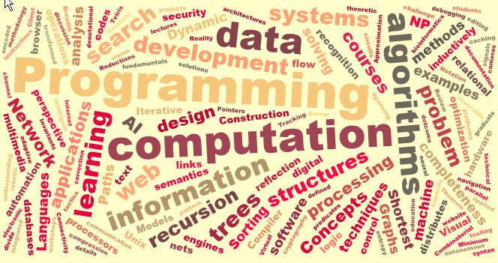
Australian Curriculum Subject: Digital Technologies
Although all areas of the curriculum will contribute to a student's ICT capability on its own this would not be systematic or comprehensive. Therefore the Technologies Digital Technology strand is the enabler that takes responsibility for ensuring students develop a systematic and comprehensive capability- it makes use of the ICT contributions in other learning areas, and goes beyond the minimum requirements of the ICT General Capability. This is the same relationship as Mathematics has to numeracy and English has to literacy.

Slide 6
The ICT General Capability
“it underpins and informs our learning and teaching and should be explicit i.e. clearly Identified within each learning area subject program”…
“is a key dimension of the Australian Curriculum, and should be taught in the content of the learning areas…”

Slide 7
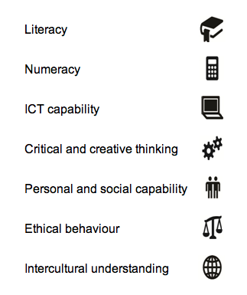
What are the General Capabilities?
The Capabilities are Identified by these symbols in the Curriculum:
The Australian Curriculum is underpinned by seven (7) General Capabilities. These are:
Literacy
Numeracy
Information & communication technology capability
Critical and creative thinking
Ethical behaviour
Personal and social capability
Intercultural understanding.

Slide 8
The General Capabilities
are those capabilities deemed essential to assist students ‘manage their life, learning and work’ throughout their lifespan.
They are the knowledge, skills, behaviours and dispositions that will assist students to live and work as successful independent learners and as active, confident, creative and informed individuals (Shape of the Australian Curriculum – ACARA, December 2010).
IT IS THE RESPONSIBILITY OF ALL TEACHERS
TO ASSIST STUDENTS TO DEVELOP THESE GENERAL CAPABILITIES

Slide 9
From a Broader Perspective … the notion of general capabilities are not new! …
In Australia, there are a number of existing arrangements to address general capabilities/non-technical skills:
Employability Skills Framework used in the Vocational Education and Training sector.
Graduate Attributes developed by universities.
Australian Core Skills Framework, foundation skills for the workforce.
The Australian Blueprint for Career Development, which addresses career management competencies considered essential for life long learning.
The Australian Qualifications Framework, which spans all education and training sectors, also refers to four broad categories of Generic Skills.
The Overarching Outcomes, WA Curriculum Framework, and now the
General Capabilities that form part of the new Australian Curriculum for schools.
(Employability Skills Framework Stage 1, Final Report , DEEWR, January 2012).

Slide 10
The General Capabilities
The General Capabilities are addressed through the learning areas and are identified where they offer opportunities to add depth and richness to student learning in content elaborations. http://www.australiancurriculum.edu.au/English/Curriculum/F-10
Where can I find more Information about the General Capabilities?The General Capabilities are on the Australian Curriculum website.
Notes:
Should we show examples here of how teachers use ICT General Capability to add depth & richness?

Slide 11
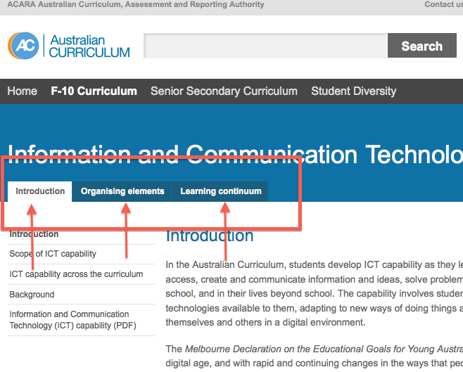
The General Capabilities
All of the Seven (7) General Capabilities like the ICT Capability consist of three sections:
Introduction
Organising elements
A continuum across stages of schooling

Slide 12
ICT as a GENERAL CAPABILITY
All of the Seven (7) General Capabilities like the ICT Capability consist of three sections:
Introduction
Organising elements
A continuum across stages of schooling
1. Introduction
“…The capability involves students in learning to make the most of the digital technologies available to them, adapting to new ways of doing things as technologies evolve and limiting the risks to themselves and others in a digital environment …”

Slide 13
ICT as a GENERAL CAPABILITY
Five Interrelated Elements
All of the Seven (7) General Capabilities like the ICT Capability consist of three sections:
Introduction
Organising elements
A continuum across stages of schooling

Slide 14
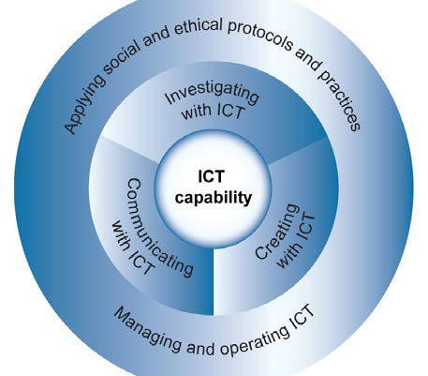
ICT as a GENERAL CAPABILITY
2. Organising Elements
Five Interrelated Elements
The ICT capability is organised into five (5) interrelated elements:
Investigating with ICT
Creating with ICT
Communicating with ICT
Managing and operating ICT
Applying social and ethical protocols and practices

Slide 15
ICT as a GENERAL CAPABILITY
All of the Seven (7) General Capabilities like the ICT Capability consist of three sections:
Introduction
Organising elements
A continuum across stages of schooling
Learning Continuum

Slide 16
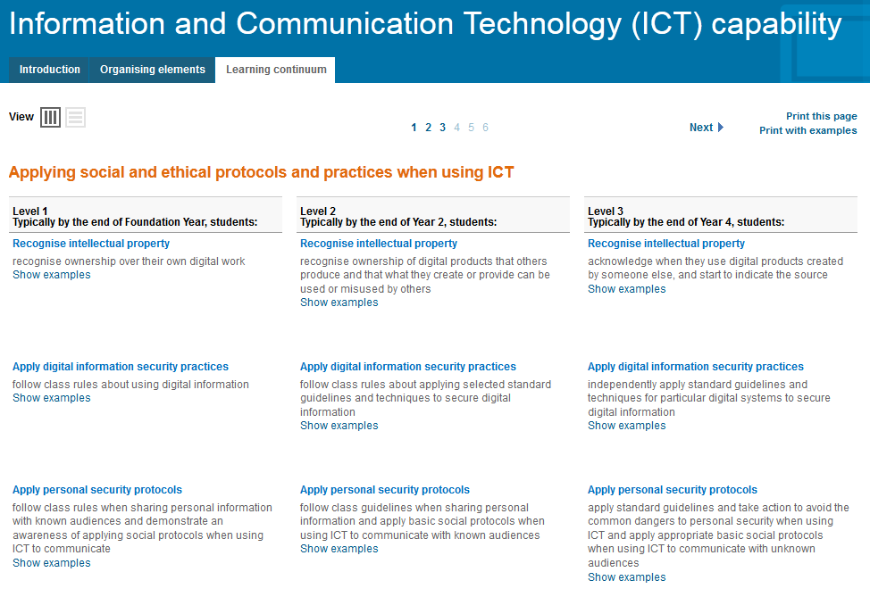
ICT as a GENERAL CAPABILITY

Slide 17
Using ICT General Capability to add depth & richness
Read one of the articles listed at www.ictexpo.weebly.com under the “Workshop” tab [Task 1]
Write your thoughts about these articles and how these teachers are integrating ICT capabilities on [http://todaysmeet.com/6may] this can be accessed via the www.ictexpo.weebly.com in the “workshop” tab or the home page.
Notes:
Direct participants to ictexpo.weebly.com - “workshop” tab

Slide 18
TEACHING & ASSESSMENT OF ICT AS A GENERAL CAPABILITY
Teachers are expected to teach and assess General Capabilities to the extent that they are incorporated and identified within each learning area
Good teaching in each of the learning areas will always contribute to a student’s development of General Capabilities.
How do you presently cover the ICT capability?
Type your answer into:
Padlet [http://padlet.com/wall/ztz7jv2gyo]
Notes:
Participants enter padlet via www.ictexpo.weebly.com and list all the ways they believe they are currently incorporating the ICT General Capability. I think we should get them to specifically list HOW they incorporate ICT G.C. not ALL the capabilities.

Slide 19
DIGITAL TECHNOLOGIES LEARNING AREA
ICT as a field of study

Slide 20
TECHNOLOGIES AS A LEARNING AREA
Australian Curriculum: Technologies adopted to reflect the range of technologies addressed in schools
Australian Curriculum:
2 strands F-8 and
2 subjects Years 9-12
Design and Technologies
Digital Technologies
Notes:
Technologies is the name chosen to address the learning area. It was selected to encompass the broad range of technologies and experiences on offer to students in schools.
The proposed structure comprises two strands (Years F-8) and two subjects (Years 9-12).
It is based on the assumption that all students are entitled to study both Design and technologies and Digital technologies from Foundation to the end of Year 8.
In Years 9-12 students will be able to choose from a range of subjects developed by ACARA and states and territories across a number of learning areas.

Slide 21
TECHNOLOGIES AS A LEARNING AREA
DESIGN & TECHNOLOGIES
DIGITAL TECHNOLOGIES
students learn to develop and apply technologies knowledge, process and production skills to design, produce and evaluate solutions using traditional, contemporary and emerging technologies for real-world needs, opportunities, end users, clients or consumers in a range of technologies contexts.
students learn to develop and apply technical knowledge, process and computational thinking skills, including algorithmic logic and abstraction, to transform data into information solutions for real-world needs, opportunities, end users, clients or consumers in a range of technologies contexts.
Notes:
These descriptions of the two subjects/strands are provided in the Background statement. Greater detail appears in the Structure of the Australian Curriculum and the Scope and sequence.

Slide 22
Structure of the Australian Curriculum: Technologies
TWO STRANDS
1.
Design and Technologies
The Australian Curriculum: Technologies comprises two strands:
Design and technologies & Digital technologies.
All students will study both Design and technologies and Digital technologies from Foundation to the end of Year 8.
Schools may choose to integrate the strands in teaching and learning programs F-8.
In Years 9–12, students will be able to choose from a range of subjects developed by ACARA and states and territories. In WA this will involve the existing elective subjects in the Technologies Curriculum.
2.
Digital Technologies
Notes:
While the curriculum is presented as two discreet strands, it will not preclude schools from integrating the strands in teaching and learning programs. Integration is the central pedagogy found in early years, and a key strength for meaningful learning in the Technologies curriculum.

Slide 23
Structure of the Australian Curriculum: Technologies
TWO STRANDS
TWO SUB-STRANDS
Knowledge and Understanding
Processes and Production
1.
Design and Technologies
2.
Digital Technologies
There are also two complimentary sub-strands
Knowledge and Understanding
Processes and Production
Notes:
A complementary sub-strand structure has been developed to highlight similarities across the learning area and facilitate integrated approaches to teaching both strands in YearF-8 if desired.
The intent is for teachers to select technologies-specific content from the Knowledge and understanding sub-strand and ask students to apply the content using the skills in the Processes and production sub-strand.

Slide 24
Relationship between the sub-strands
 | DESIGN & TECHNOLOGIES | DIGITAL TECHNOLOGIES
Knowledge and Understanding | focuses on materials, information, systems, tools and equipment; and technologies and society. The content is dependent on the technologies context. | focuses on digital information, digital systems and technologies, and digital technologies and society.
Processes and Production | focuses on designing - identifying, exploring and critiquing a need or opportunity; generating, researching and developing ideas; and planning, producing and evaluating solutions that utilise process and production skills, creativity, innovation and enterprise to promote the development of sustainable patterns of living. | focuses on formulating and investigating problems; analysing and creating digital solutions; representing, constructing and evaluating solutions; and utilising skills of creativity, innovation and enterprise for sustainable patterns of living.
Notes:
Knowledge and understanding sub-strand is common to both Design and technologies and Digital technologies.
Processes and production has different emphasis:
Design and technologies Processes and production – design, produce and evaluate
Digital technologies Processes and production - create digital solutions

Slide 25
Organisation of the Australian Curriculum: Technologies
Time Allocation
The technologies curriculum is organised in the following bands:
Foundation to Year 2
Years 3-4
Years 5-6
Years 7-8
Years 9-10
Senior secondary (Years 11 and 12)
The time allocation for Design and technologies and Digital technologies combined are:
• 60 hours across Years F–2
• 80 hours across Years 3–4
• 120 hours across Years 5–6
• 160 hours across Years 7–8
• 80 hours each across Years 9–10
• 200 to 240 hours of learning across Years 11–12 for each of Design and technologies and Digital technologies.
Allocation of time for teaching the Technologies learning area will be a school authority or school-based decision.
Notes:
Subject/strand specific overview of the proposed continuum of learning in Design and technologies.
For any year, the Australian Curriculum is written so that it should not take up more than 80% of the total teaching time available. The time allocated for teaching the Australian Curriculum: Technologies is a decision to be made by state and territory jurisdictions.
These are indicative, minimum hours relating to the Australian Curriculum.
Is the notional time allocation for Technologies F-10 appropriate?

Slide 26
Digital Technologies across the years of schooling
Addresses each of the Stages F-12.
Specific examples of content description
Continuum of learning:
Students will develop increasingly sophisticated knowledge and understanding, drawn from both contemporary and historical sources
Students will develop increasingly sophisticated skills in digital technologies processes and production through applying computational thinking to create digital information products, systems or software instructions to address digital problems.
Notes:
Subject/strand specific overview of the proposed continuum of learning in Digital Technologies.

Slide 27
Australian Curriculum: Technologies
Strand: Digital Technologies
Sub Strand: Digital Technologies processes and production skills
Year Cohort: Year 5-6
Content Descriptors:
6.7 Design and implement digital solutions using visual programs with user input, branching and iteration
Elaborations: e.g.
• planning and implementing a solution using a visual programming language, for example designing and creating a simple computer game, suitable for younger children, that requires user input to make selections, taking into account intuitive responses of the audience
• experimenting with different programming options that involve repeat instructions
• designing and creating a solution that repeats a motion, for example creating an animation that repeats a movement

Slide 28
Using Scratch
6.7 Design and implement digital solutions using visual programs with user input, branching and iteration
On uTube: http://www.youtube.com/watch?v=0pxaFzRtx7k

Slide 29
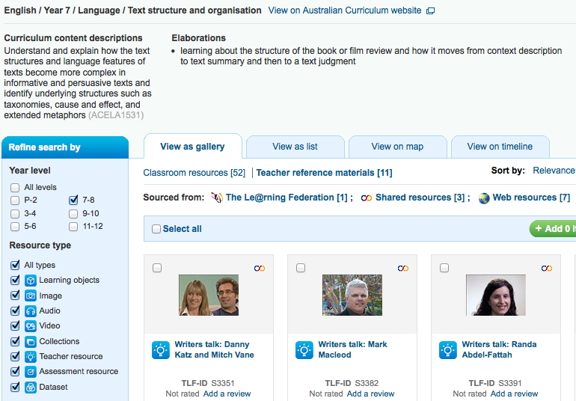
Resource Support – C.N.A. Scootle
Go to http://ims.cathednet.wa.edu.au
ID: <surname.firstname> Password: <your CathEdNet email password>
Another Resource Foundation - 10 “ICT across four Domains”
https://docs.google.com/document/pub?id=1dA5idOGlWJdOHSgNhhMnNjTJpVtqdLwSLoatFo0vOhk

Slide 30
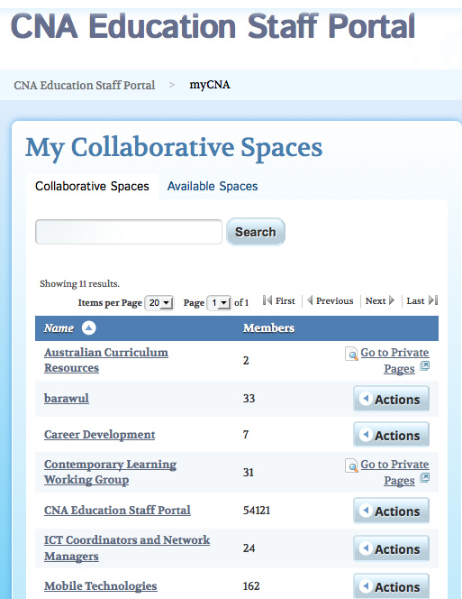
CATHOLIC NETWORK AUSTRALIA (C.N.A.)
Models of Contemporary Learning Collaborative Spaces
Notes:
.

